Slide 1
Scientific Text Mining and Knowledge Graphs Chapter 2 Part 1: Taxonomy Construction
Presenter: Jingbo Shang
University of California, San Diego
jshang@ucsd.edu
Notes:
Thank you for the introduction!
Good morning, everyone!
This is Jingbo Shang from UIUC. I’m very excited to share my research with you!
My talk today is mainly about AutoNet. Automated Network Construction from Massive Text Corpora.

Slide 2
What is a taxonomy?
Taxonomy is the practice and science of describing and organizing concepts

Slide 3
Example: ACM CCS Taxonomy
A concept is represented
by a single term
General Concept
Specific Concepts
https://dl.acm.org/ccs/ccs.cfm

Slide 4

Example: eBay Product Taxonomy
Specific concepts
General concepts
A concept is represented by a small term cluster
Most specific concepts
https://www.ebay.com/n/all-categories

Slide 5
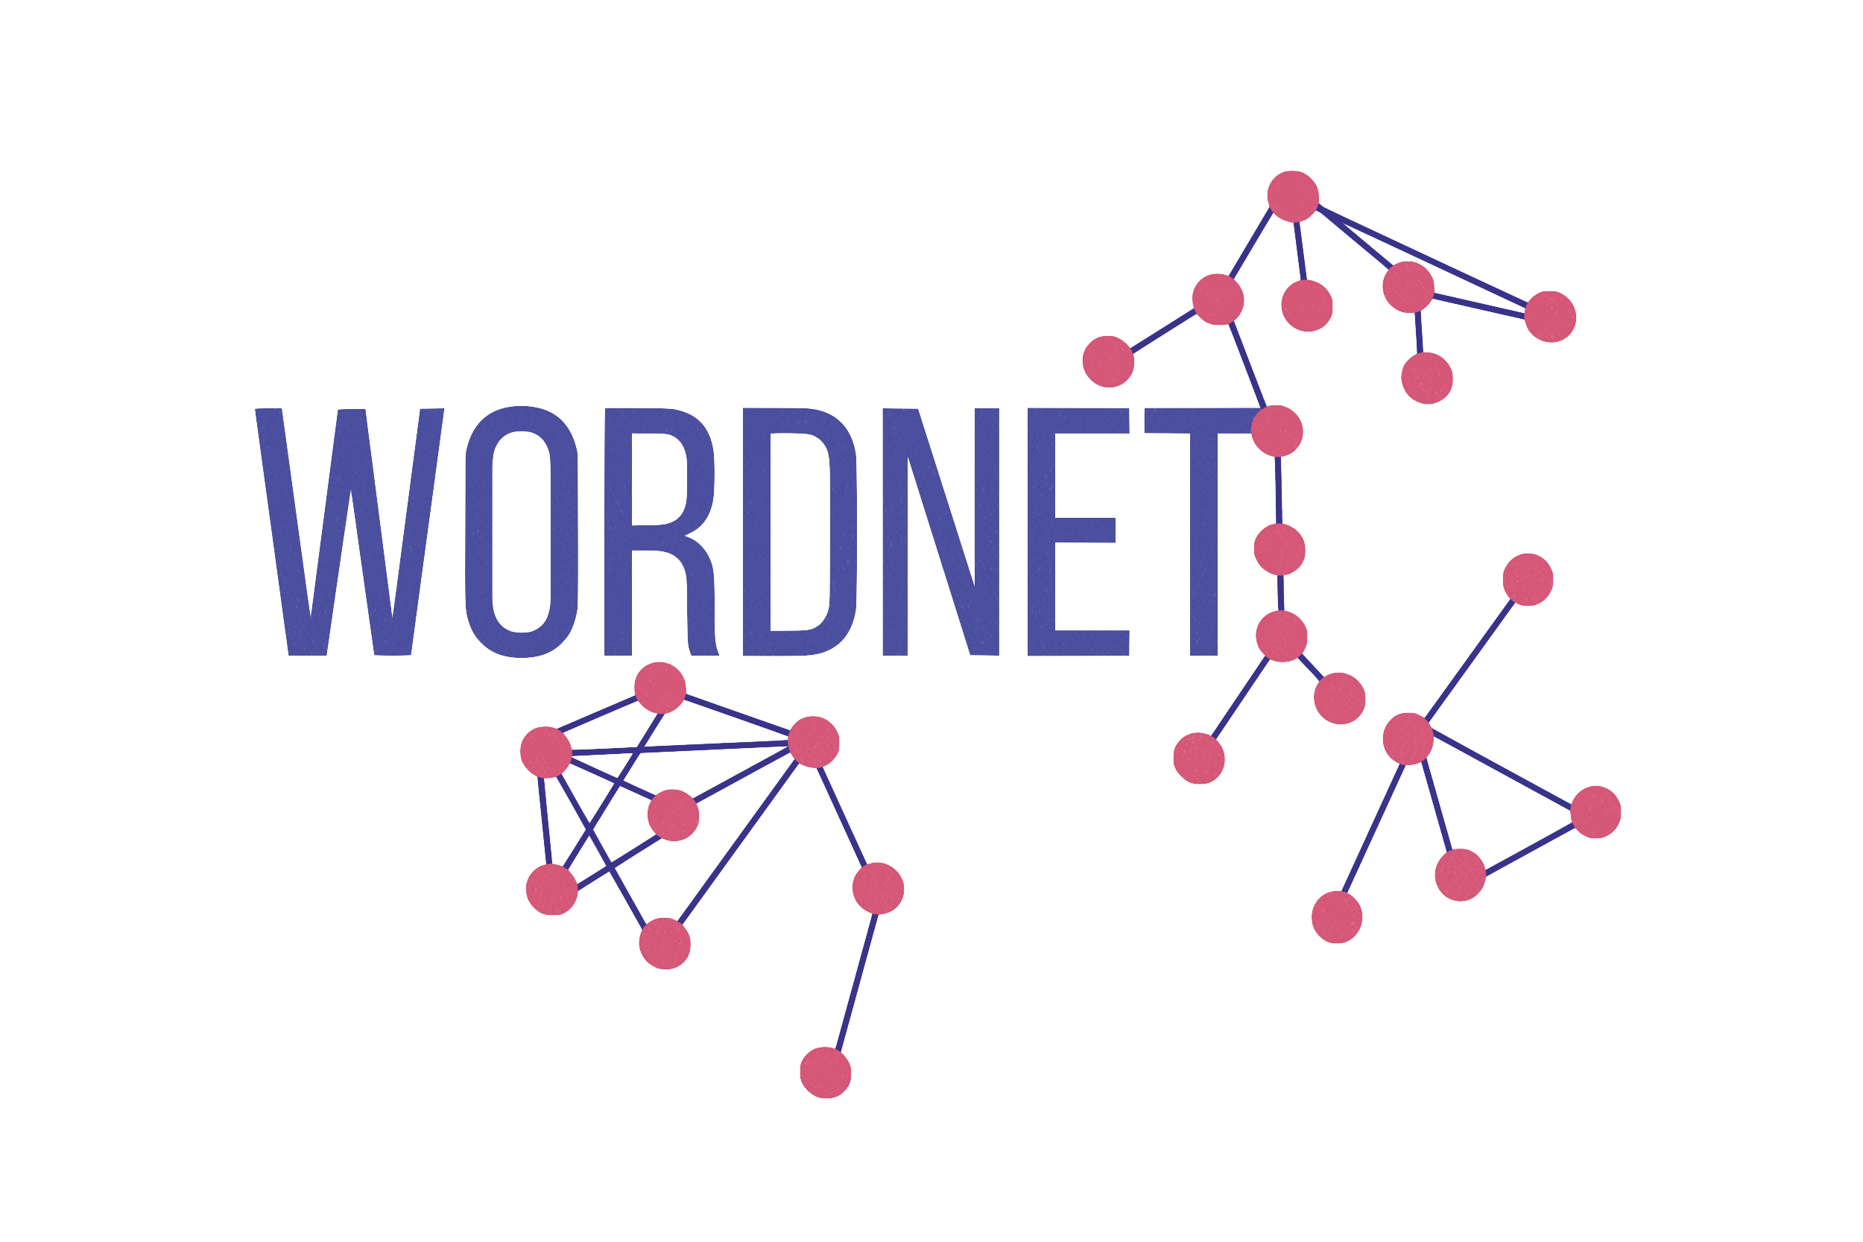





Two General Types of Taxonomy
Each concept in the taxonomy is called a taxon and based on how we represent a taxon, we categorize taxonomies into two types:
Instance-based Taxonomy – each taxon is a single term (+ strict synonyms)
Clustering-based Taxonomy – each taxon is a topically related term cluster

Slide 6




Taxonomy Underpins Digital Library
Scientific Papers
Document
Categorization
Taxonomy
Data Mining Papers
Theory Papers
HCI Papers

Slide 7
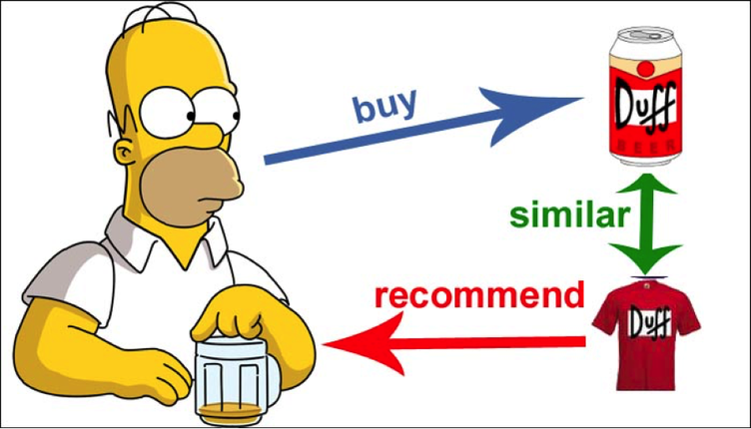
Taxonomy Helps Search & Recommendation
Processing Unit
Search
Return
Recommendation
GPU
TPU
GPU
view
Search
Purchase
Processing Unit
similar
Recommend
TPU

Slide 8



How to Build a Taxonomy?
Manual curation
Time-consuming and expensive
Human (expert) labor-intensive
Automated construction
Scalable and extensible

Slide 9
Typical Taxonomy Construction Process
Extract Terms
Determine Taxonomic Relations
Construct Taxonomy Global Structure
Decide Taxon Representation
What data sources you have?
Raw text? Query logs? Clicks? Networks?
What type of taxonomy you want?
Instance-based? Clustering-based?
Focus of this part of tutorial
What type of relation you want?
Is-A relation? Part-of relation? Other relation?
How many supervision you have?
Many labeled taxonomies? Several seed taxons?

Slide 10
Taxonomy Construction Methods: A Landscape
Structure level
For a more comprehensive landscape see: https://github.com/mickeystroller/awesome-taxonomy
Focus of this tutorial
hLDA [Blei et al.’03]
CATHY [Wang et al.’13a]
TaxoGen [Chao et al.’18]
NetTaxo [Shang et al.’20]
SSHLDA [Mao et al.’12]
HDM [Wang et al.’14]
Clustering-based taxonomy
HSLDA [Perotte et al.’11]
Instance-based taxonomy
Probase [Wu et al.’12]
OntoLearn [Velardi et al.’13]
WiBi [Flati et al.’14]
STI [Snow et al.’06]
SL-MST [Bansal et al.’14]
TaxoRL [Mao et al.’18]
HiExpan [Shen et al.’18]
Taxonomic relation
Hearst Pattern [Hearst’92]
DIVE [Chang et al.’18]
U-TEAL [Wang et al.’19]
SOL [Nakashole et al.’12]
MetaPAD [Jiang et al.’17]
Piecewise-LP [Fu et al.’14]
HypeNET [Shwartz et al.’16]
Label Amount
No
supervision
A few labeled supervision
Fully labeled relations/taxonomies

Slide 11
Constructed Topic Taxonomy: Example
*
computer vision
optical flow
object recognition
face recognition
…
feature selection
reinforcement learning
active learning
model selection
…
data mining
knowledge discovery
social network
recommender systems
…
natural language
machine translation
statistical machine translation
question answering
…
…
Topic: Computer Vision
Topic: Machine Learning
Topic: Data Mining
Topic: Natural Language Processing
…
…
…
…
…
…
…
…
…
…
…
…
association rules
association rule mining
frequent patterns
sequential patterns
…
link prediction
community detection
graph clustering
large graphs
…
social media
social networks
social network
online social networks
…
…
Topic: Frequent Pattern and Association Rule Mining
Topic: Graph Mining
Topic: Social Network Analysis
…
…
…
…
…
…
…
…
…
…
…
…
Notes:
Let me first explain what is a topic taxonomy.
It is a tree-like structure.
Every node represents a topic.
Every topic is described by a cluster of semantically coherent terms.
For example, this is a topic taxonomy we constructed for computer science papers.
These nodes represent the topics of computer vision, machine learning, data mining, natural language processing, frequent pattern and association rule mining, graph mining, and social network analysis.

Slide 12
Why Topic Taxonomy?
Structures networks in a hierarchical way
Provides a holistic view
Enables efficient drill-downs
Summarizes knowledge & insights
……
Notes:
The topic taxonomy can structure the network in a hierarchical way.
It provides you a holistic view before you look at the specific nodes and edges.
So you can easily locate the sub-network that you are interested in.
The terms in each node also help you summarize the knowledge and insights.
Therefore, topic taxonomy helps us better explore the constructed network.

Slide 13
Hierarchical Topic Model
Use a cluster of terms (i.e., a topic) to represent a concept and organize topics in a hierarchical way
Pose different statistical assumptions on the data generation process
Nested Chinese Restaurant Process:
hLDA [Blei et al.’03], hLDA-nCRP [Blei et al.’ 10]
Pachinko Allocation Model:
PAM [Li and McCallum’06], hPAM [Mimno et al.’07]
Dirichlet Forest Model：
DF [Andrzejewski et al.’09], Guided HTM [Shin and Moon’17]
Notes:
There are many existing methods on constructing topic taxonomy and most of them are using term embedding.
Term embedding, or word embedding, is a technique that projects terms into a latent space while preserving the proximity between terms. Terms sharing similar contexts are likely to be projected into nearby positions.
Using term embedding, existing taxonomy construction methods apply hierarchical clustering methods to group the nearby terms together and form clusters. By applying this idea recursively, we can then get a topic taxonomy.
This idea works well at the first level. However, as we go deeper in the taxonomy, the term embedding has its limitation.

Slide 14
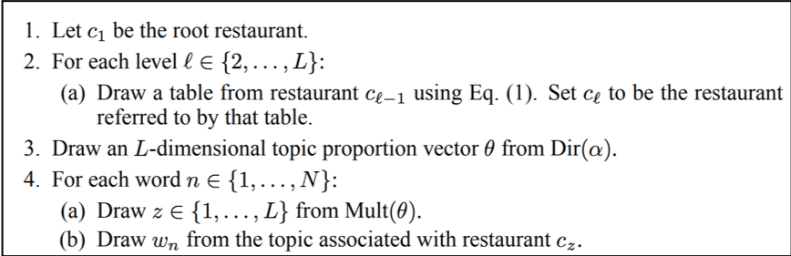
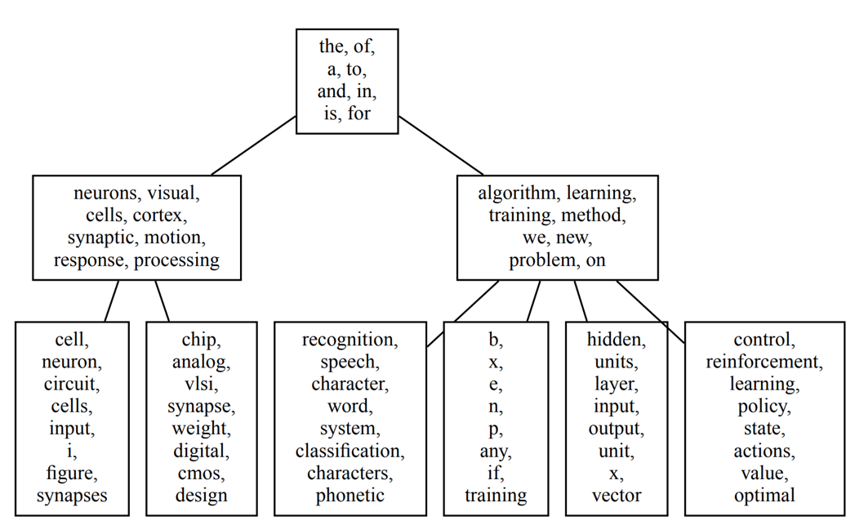
Example: hLDA
Document generation from Chinese Restaurant Process
Generates
We develop an approach to risk minimization and stochastic optimization that provides a convex surrogate for variance, allowing near-optimal and computationally efficient trading between approximation and estimation error.
Inference
“Observed” documents
Figure credits to [Blei et al.’03]
Notes:
There are many existing methods on constructing topic taxonomy and most of them are using term embedding.
Term embedding, or word embedding, is a technique that projects terms into a latent space while preserving the proximity between terms. Terms sharing similar contexts are likely to be projected into nearby positions.
Using term embedding, existing taxonomy construction methods apply hierarchical clustering methods to group the nearby terms together and form clusters. By applying this idea recursively, we can then get a topic taxonomy.
This idea works well at the first level. However, as we go deeper in the taxonomy, the term embedding has its limitation.

Slide 15
Example: hPAM
Document generation from Pachinko Allocation Model
super-topic
sub-topic
Generates
We develop an approach to risk minimization and stochastic optimization that provides a convex surrogate for variance, allowing near-optimal and computationally efficient trading between approximation and estimation error.
Inference
“Observed” documents
Figure credits to [Mimno et al.’07]
Notes:
There are many existing methods on constructing topic taxonomy and most of them are using term embedding.
Term embedding, or word embedding, is a technique that projects terms into a latent space while preserving the proximity between terms. Terms sharing similar contexts are likely to be projected into nearby positions.
Using term embedding, existing taxonomy construction methods apply hierarchical clustering methods to group the nearby terms together and form clusters. By applying this idea recursively, we can then get a topic taxonomy.
This idea works well at the first level. However, as we go deeper in the taxonomy, the term embedding has its limitation.

Slide 16
Hierarchical Clustering
Group terms into hierarchical clusters and each cluster represents an interested concept
Top-down approaches:
CATHY [Wang et al.’13a]
CATHYHIN [Wang et al.’13b]
Bottom-up approaches:
BRT [Liu et al.’12] [Song et al.’ 15]
Notes:
There are many existing methods on constructing topic taxonomy and most of them are using term embedding.
Term embedding, or word embedding, is a technique that projects terms into a latent space while preserving the proximity between terms. Terms sharing similar contexts are likely to be projected into nearby positions.
Using term embedding, existing taxonomy construction methods apply hierarchical clustering methods to group the nearby terms together and form clusters. By applying this idea recursively, we can then get a topic taxonomy.
This idea works well at the first level. However, as we go deeper in the taxonomy, the term embedding has its limitation.

Slide 17
Example: CATHY [Wang et al.’13a]
Step 1: Construct term co-occurrence network
Step 2: Cluster co-occurrence network into subtopic’s sub-networks and estimate each sub-topical phrase’s frequency
Step 3: Extract candidate phrases using topical frequency
Step 4: Rank topical phrases based on topical frequency
Step 5: Apply steps 2-5 to each subtopic recursively and construct the hierarchy in a top-down fashion
Notes:
There are many existing methods on constructing topic taxonomy and most of them are using term embedding.
Term embedding, or word embedding, is a technique that projects terms into a latent space while preserving the proximity between terms. Terms sharing similar contexts are likely to be projected into nearby positions.
Using term embedding, existing taxonomy construction methods apply hierarchical clustering methods to group the nearby terms together and form clusters. By applying this idea recursively, we can then get a topic taxonomy.
This idea works well at the first level. However, as we go deeper in the taxonomy, the term embedding has its limitation.

Slide 18
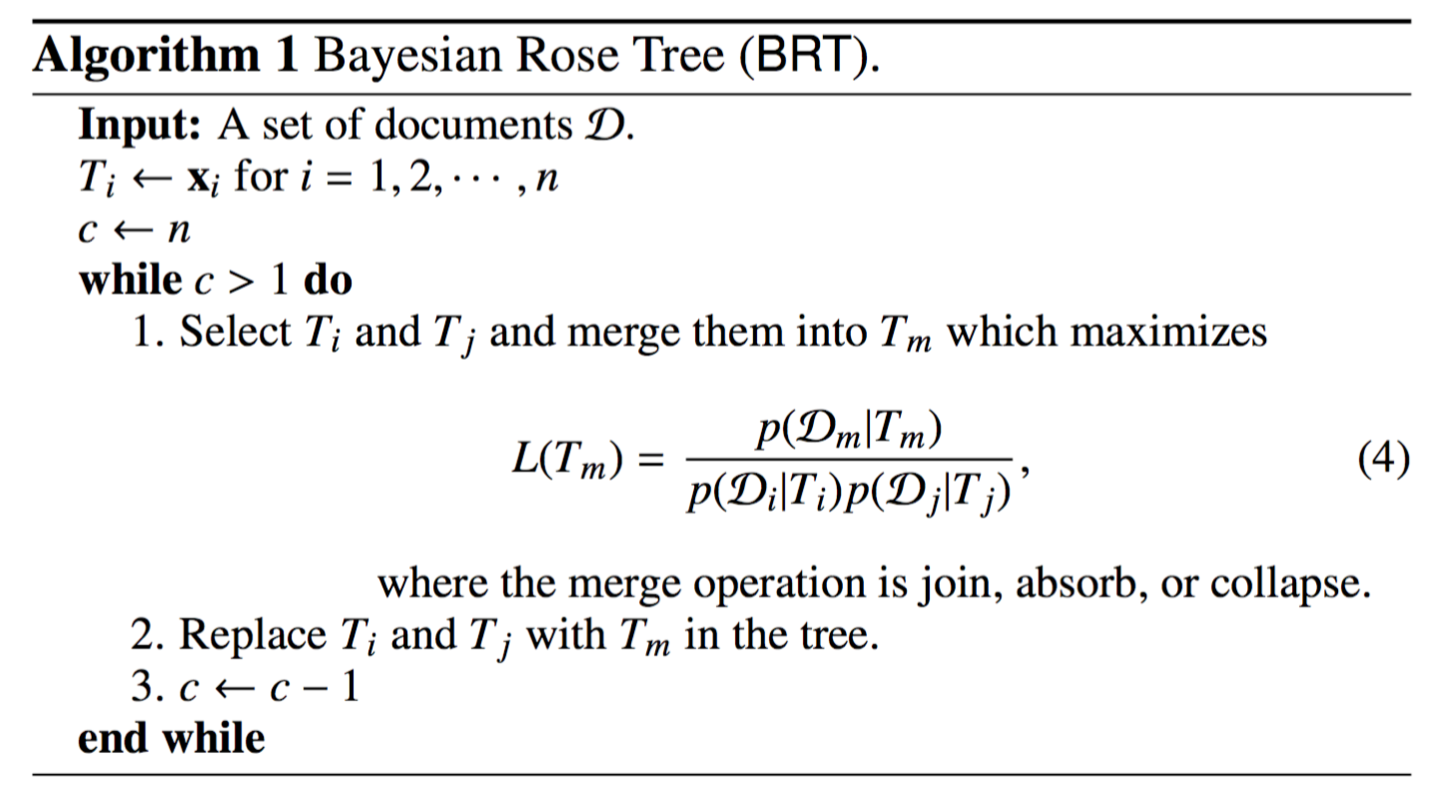
Example: BRT [Liu et al.’12]
Agglomerative multi-branch clustering using Bayesian Rose Tree
Join:
Absorb:
Collapse:
Notes:
There are many existing methods on constructing topic taxonomy and most of them are using term embedding.
Term embedding, or word embedding, is a technique that projects terms into a latent space while preserving the proximity between terms. Terms sharing similar contexts are likely to be projected into nearby positions.
Using term embedding, existing taxonomy construction methods apply hierarchical clustering methods to group the nearby terms together and form clusters. By applying this idea recursively, we can then get a topic taxonomy.
This idea works well at the first level. However, as we go deeper in the taxonomy, the term embedding has its limitation.

Slide 19
Limitations of Previous Methods
Too strong assumptions on document generation process
Bag-of-word document representation ignores word order information
Real-world data may not follow these statistical distributions/processes
Computationally slow
Slow inference restricts their applications to large-scale data
Notes:
There are many existing methods on constructing topic taxonomy and most of them are using term embedding.
Term embedding, or word embedding, is a technique that projects terms into a latent space while preserving the proximity between terms. Terms sharing similar contexts are likely to be projected into nearby positions.
Using term embedding, existing taxonomy construction methods apply hierarchical clustering methods to group the nearby terms together and form clusters. By applying this idea recursively, we can then get a topic taxonomy.
This idea works well at the first level. However, as we go deeper in the taxonomy, the term embedding has its limitation.

Slide 20
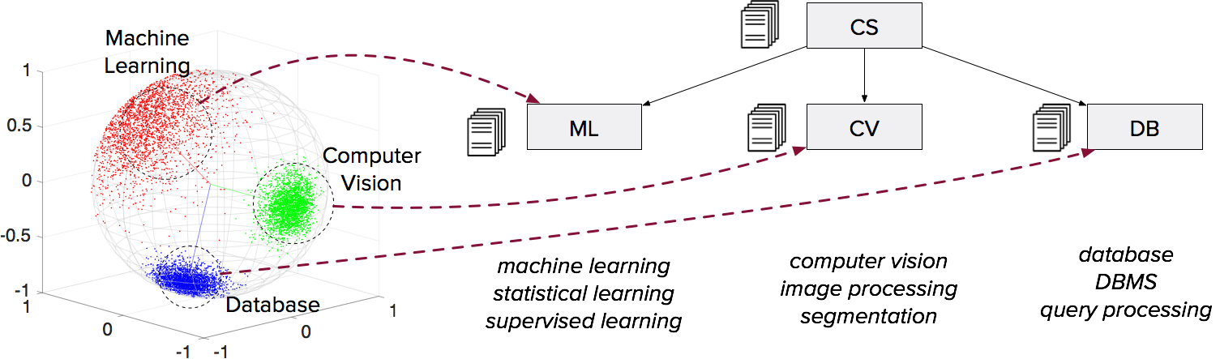
Recent Methods: Uses Term Embedding
Most existing work follows this idea: using term embedding to construct topic taxonomy based on hierarchical clustering
Learns term embedding to capture their semantic correlations
Constructs topic taxonomy in a recursive, top-down fashion
Notes:
There are many existing methods on constructing topic taxonomy and most of them are using term embedding.
Term embedding, or word embedding, is a technique that projects terms into a latent space while preserving the proximity between terms. Terms sharing similar contexts are likely to be projected into nearby positions.
Using term embedding, existing taxonomy construction methods apply hierarchical clustering methods to group the nearby terms together and form clusters. By applying this idea recursively, we can then get a topic taxonomy.
This idea works well at the first level. However, as we go deeper in the taxonomy, the term embedding has its limitation.

Slide 21
Limitation of Term Embedding: Example
Two terms in the Computer Science publications
“Frequent Pattern” vs. “Transaction Database”
From the taxonomy view
We should separate them into “Data Mining” and “Database”
From the term embedding view
They are very similar due to similar contexts
SIGKDD &
Data Mining
Researchers
SIGMOD &
Database
Researchers

Slide 22
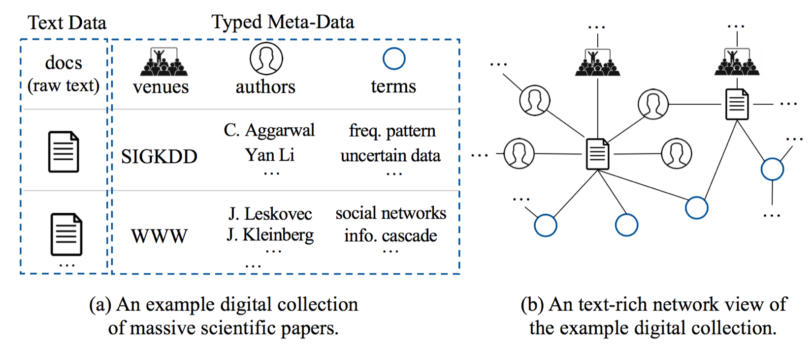
Text-Rich Network: Text & Meta-Data
Terms are extracted by AutoPhrase from raw texts (e.g., paper & review)

Slide 23
Network Motifs: Contexts from Network
Motif patterns capture subgraph contexts
Those nodes “connecting” two terms describes contexts
Meta-path can be viewed as a special case of motif
T-P-T, T-P-V-P-T, T-P-A-P-T, …
Motif Pattern
Motif Instance
More Motif Patterns

Slide 24
Text-Network Collaboration: Challenges
Motif patterns are not created equally, even given by human experts
Motif instances of the same motif patterns are not equally informative
More effective at fine-grained levels
More effective at coarse-grained levels
vs.
SIGKDD vs. SIGMOD
More diverse venues
More focused venues

Slide 25
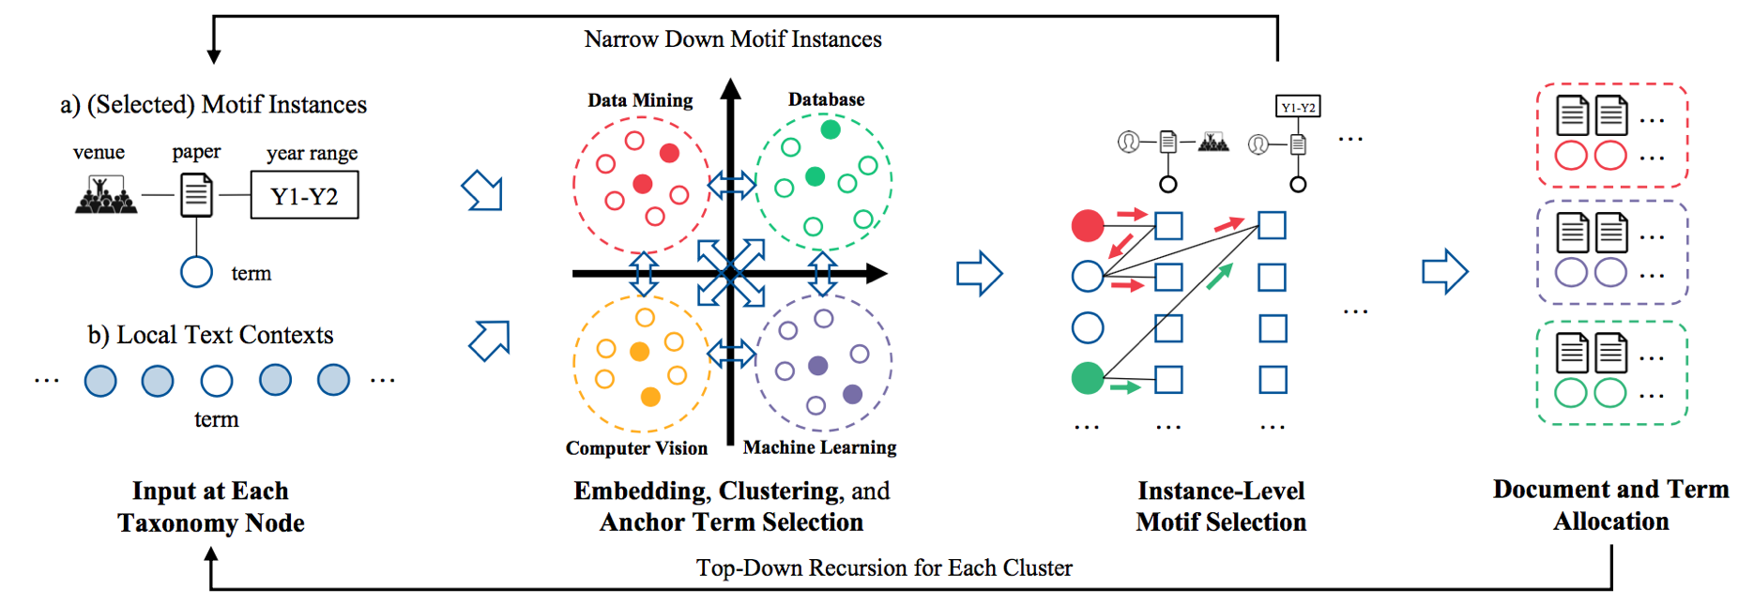
NetTaxo: Instance-Level Motif Selection
Starts from term embedding using textual contexts only
Anchor terms makes the initial clustering results more robust
Joint term embedding based on selected motif instances & textual contexts

Slide 26
NetTaxo: Joint Clustering Results (CS domain, 1st level)
*
data mining
knowledge discovery
social network
recommender systems
social media
social networks
collaborative filtering
link prediction
social network analysis
web search
natural language
machine translation
statistical machine translation
question answering
dependency parsing
word sense disambiguation
coreference resolution
natural language processing
word order
word alignment
feature selection
reinforcement learning
active learning
model selection
gaussian process
neural networks
learning algorithms
decision trees
function approximation
gaussian processes
…
…
…
…
…
…
…
…
…
…
…
…
…

Slide 27
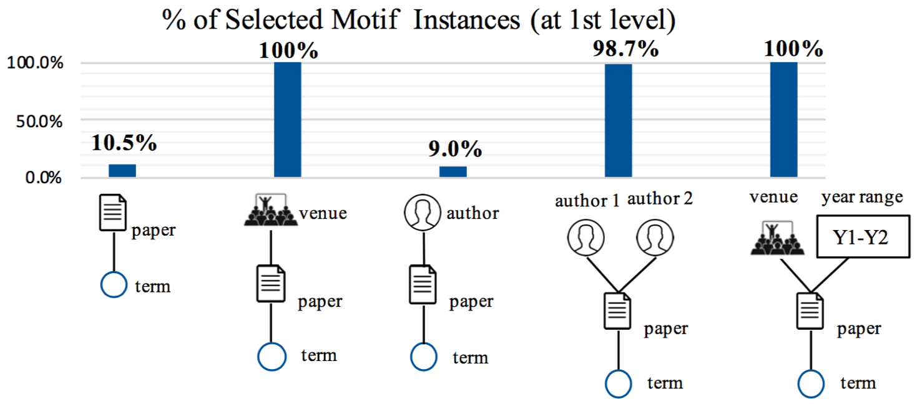
NetTaxo: Implicit Motif Pattern Selection
Instance-level selection implicitly filters useless motif patterns too

Slide 28
Case Study: Selected Motif Instances I
Interesting motif instances selected at different levels
Author pairs with more focused research topics are selected at the 2nd level

Slide 29
Case Study: Selected Motif Instances II
Interesting motif instances selected at different levels
Recent, diverse & early, focused venues may help at the 2nd level

Slide 30
NetTaxo: Evaluation Metrics
Coherence Measure
Are the terms at the same taxonomy node coherent?
Sibling Exclusiveness
Are the terms at a taxonomy node more similar compared to the terms at its sibling nodes?
Parent-Child Relationship
Are the relationships between the taxonomy nodes correct?
All metrics are between 0 and 1; The bigger, the better.
Notes:
After looking at so many examples, let’s evaluate NetTaxo more systematically.
We mainly look at the following three measurements.
In an ideal topic taxonomy, every node should have semantically coherent terms, the terms in different nodes must represent different concepts, and the parent-child relationships must be correct.
All these measures are between 0 and 1. The bigger, the better.

Slide 31
NetTaxo: Experimental Results
Two domains: CS papers & Yelp reviews
Compared with (“++” means “enhanced by our phrase mining results”)
TaxoGen (KDD’18) & HPAM++: Using text data only
CATHYHIN++ (ICDM’13, TKDE’18): Using network data only
HClusEmbed (NeurIPS’13, WWW’15): combines both term and node embeddings
Notes:
We compared NetTaxo with the previous state-of-the-art method TaxoGen, which was just published in last year’s KDD, the best data mining conference.
TaxoGen mainly relies on the term embedding.
It has outperformed many baselines, including hierarchical LDA and hierarchical clustering.
CATHYHIN is a method using network structure.
However, at that time there is no phrase mining method yet.
So we upgrade CATHYHIN by integrating it with our AutoPhrase.
So it is called CATHYHIN++.
We also compare with a method that simply combines both term and node embeddings.
The results are demonstrated in the Table. As you can see here, NetTaxo achieved the best performance among all these methods. TaxoGen has a slightly higher coherence, but its relationship is very poor. So NetTaxo is the best method among these four.

